Slide 1
PDF Accessibility
The How, the Why, and the Why Not’s
Carly Gerard, CPACC
Accessibility Engineer, Web Communication Technologies
Notes:
Hello and thank you for viewing this presentation on PDF Accessibility.... I hope you are staying this spring quarter. For those that don’t know me, I am Carly Gerard, a web accessibility engineer in Web Communication Technologies here on campus. I help ensure our web platforms like WordPress, Drupal, and static sites are accessible for users, and provide guidance on creating accessible digital content—hence the presentation today on PDFs.

Slide 2
PDF: What Is It?
A subtitle for the section
Notes:
To start, it's important to understand what PDF is intended for.

Slide 3
Portable Document Format (PDF)
The Purpose
“…to present and exchange documents reliably — independent of software, hardware, or operating system.”
—Adobe’s website
Notes:
The Purpose
the purpose of a portable document format, or PDF, is to present and exchange documents reliably, independent of software, hardware, or operating system. What does this mean?

Slide 4
Portable Document Format (PDF) Cont’d
The format of the document is preserved, no matter:
Adobe app
Browser
Operating system
Notes:
It means that I could use Adobe Acrobat, or Adobe reader, and the document format is preserved. I could also use a browsers PDF viewer and no matter the browser the document will look the same. The document can also be shared from windows to Mac and vice versa and the format will be the same. This was important when programs like word and PowerPoint for Mac we're not the same as the apps for Windows. if someone created a document in Word for Windows and tried to share it with a Mac user, the file would look corrupted and just wouldn't even open. A PDF however allowed multiple operating systems to share documents-- however, this is no longer the case.

Slide 5
PDF’s Good For…
Creating print copies of a brochure, flyer, poster—a physical print copy
Filling out forms physically and digitally (more on that later)
But if it’s not either case?
Notes:
PDF's are also good for creating print copies like brochures, flyer, and posters-- pretty much anything that could be sent to a printer. PDF can also be good for filling out forms physically and digitally which we will cover later. But if it's not either of these cases?

Slide 6
Don’t Use PDF (if you can avoid it)
Other formats are way more accessible
Webpage
Word/PowerPoint/Excel
Also easier to make content accessible in mentioned formats
Your users may or may not have Adobe access
Notes:
I would say if you can avoid a PDF don't use it. This may be a little biased considering that I work in web communication technologies, but there are good reasons to consider other formats before PDF.
One is that other formats are way more accessible out of the box than PDF. Web pages are built using a markup language called HTML, which has been incorporating Accessibility features since the late 90s. Microsoft apps like word, PowerPoint, and Excel have started to emphasize accessibility into their apps since the late 2000s. While PDF introduced tagging in early 2000's, PDF's Accessibility standards weren't built in until 2012, so other formats have been more compatible for Accessibility a lot longer than PDF has.
I find it also easier to make content accessible from the authoring side either in web or Microsoft products. If you're using something like WordPress or Drupal, those systems make it easy to change heading levels as needed, to add meaningful text to hyperlinks, and Add alt text. Microsoft apps have also made it easy to add similar features. We will get into the process of adding these features in PDF, but doing so takes a bit more work.
Finally, your users may or may not have Adobe access depending on the device they use. In order to read a PDF on a smartphone, your users may have to download some kind of PDF viewer like Adobe reader. However most mobile devices come with some kind of browser built-in, which tends to be more compatible with assistive technologies, so that makes a webpage a more optimal format.

Slide 7
Hierarchy of Formats
Use Case | Recommendation
Creating a PDF to post on a website or send in an e-mail | First Choice: make a web page Second Choice: make a Word document
Creating a PDF Form | Web-based form (Esign/Drupal/WordPress)
Content is required in document format | Word/PowerPoint/Excel Document
PDF preserves legacy content | Create an accessible text-based version
Source: https://designsystem.wwu.edu/accessible-pdf-files
Notes:
There's actually a recommended hierarchy of content formats to go through before deciding on PDF.
if you're thinking of creating a PDF to post on a website, or send in an email, the first choice is make a web page if you can. If there's no website to host the info then a Word document would be the second choice.
if you're wanting to create a PDF for a form, then the form should be web based if possible. That could mean either using an E sign form, or maybe you have form capabilities in a platform like WordPress or Drupal.
If the content is needed in a document format, and was originally a word/PowerPoint/Excel document, then leaving the document in that format would be preferable-- it will be much easier to make accessible and be accessible for your users.
finally, if the PDF preserves legacy content, then it will need an accessible text based version. For example, our multimedia archive library known as MABEL has a lot of scanned archived documents so they can be viewed digitally, but would be virtually impossible to make accessible by itself. So, MABEL supplies a text based version of the scanned document so the content is still readable. You can find this info and more at western's design system site, at our accessible PDF files page.

Slide 8
Accessible PDFs
“I have to use PDF”
Notes:
But let's say you've gone through this hierarchy and you have decided that PDF is your only choice-- your content must be in PDF format, but you also need it to be accessible. There are three major steps for accessible PDF:

Slide 9
Step 1. Prepare the Document
Notes:
first, we need to prepare the source document for accessible PDF conversion.

Slide 10
Prepare the Document—Microsoft
Use accessibility best practices
Accessibility articles for Office products
Run the Accessibility Checker in Word/PowerPoint/Excel
Stay away from Publisher as a starting point
For flyers, use InDesign instead
For flowcharts, use Visio instead
Notes:
If we're preparing the source document in Microsoft, it's important to use their Accessibility best practices, which they list in their Accessibility articles. It's also key to run the Accessibility checker in any of these products before converting to PDF. This will let you know if there's any remaining issues in the document. You can find it under the Review tab in a Microsoft app
Finally, I would stay away from publisher as a starting point for a document. Unfortunately, it tends to not produce an accessible output, so for Flyers I would recommend InDesign, for flowcharts I'd recommend using Visio, basically if you're thinking of publisher try a different document creator.

Slide 11
Prepare the Document—InDesign
Set up tag mapping for defined styles
Ensures certain styles have correct heading structure when exported to PDF
Main title maps to h1, sections map to h2, subsections map to h3, etc.
Add alt text to images
InDesign Accessibility Guide: https://www.adobe.com/accessibility/products/indesign.html
Other Adobe accessibility guides: https://www.adobe.com/accessibility/products/
Notes:
There are ways to convert an InDesign document to accessible PDF as well, but the documentation for that is slim. the first recommendation from Adobe is setting up tag mapping for styles. This ensures when converted that certain styles have the right markup in PDF-- titles convert to a heading level one, sections map to a heading level 2, subsections to a heading Level 3, etc.
They also recommend adding alt text to images in the InDesign file first so when converted the images in PDF already have alt text.
InDesign has a help article specific for building Accessibility into a document, and there are other Adobe Accessibility guides specific to their products.

Slide 12
Is the document scanned, or otherwise an image of text?
If so, get a text-based version of the document
To Test: Try and highlight the text
You can highlight real text
Notes:
There are some basic checks to go through before converting a document to PDF. The first is knowing if the document is scanned, or otherwise known as an image of text. If this is the case, you need a text based version of the document. The way to test this is to try and highlight the text.
In this video example, I'm doing my best to highlight the text in this poster PDF. The problem is I can no matter How I tried to drag my cursor or no matter which way I tried to highlight the text--I simply can't. what this tells me is that this is really an image of text and not real text, which will be inaccessible to someone using screen reader technology or any other kind of text to speech technology.

Slide 13
Will the document be a form?
Prepare the form in a Word document, using proper formatting
Notes:
You also need to consider if the document will eventually become a PDF form. If so, the source document needs to be formatted optimally for becoming a PDF form.

Slide 14
Example Form (starting in Word)
Proper headings
No underlines/characters to mimic inputs
Spaces created using tab stops
Notes:
This image is an example of a form that started in Word and would eventually become PDF. First, make sure that the document has proper headings by using proper word heading styles. next, there should be no underlines or characters to mimic inputs like text fields or checkboxes. All you need to do is properly space and leave enough room for the input, and then add the input in Adobe. Using underlines or characters can introduce artifacts in PDF that would be confusing for an end user. You should also create spaces between inputs using tab stops, not just pressing the spacebar multiple times or repeatedly tabbing.

Slide 15
Creating Space
Tab once to create the tab stop, drag the tab stop in the ruler to the desired position
Notes:
To properly create this space in Word, you can tab ones to create the tab stop and then drag the tab stop in the ruler to the desired position. In this video, my cursor is placed in front of the first name label, I tab once to create the tab stop comma, and then find the corresponding tab stop in the ruler so I can create more space between the last name and first name, where we will eventually put the input in Adobe Acrobat.

Slide 16
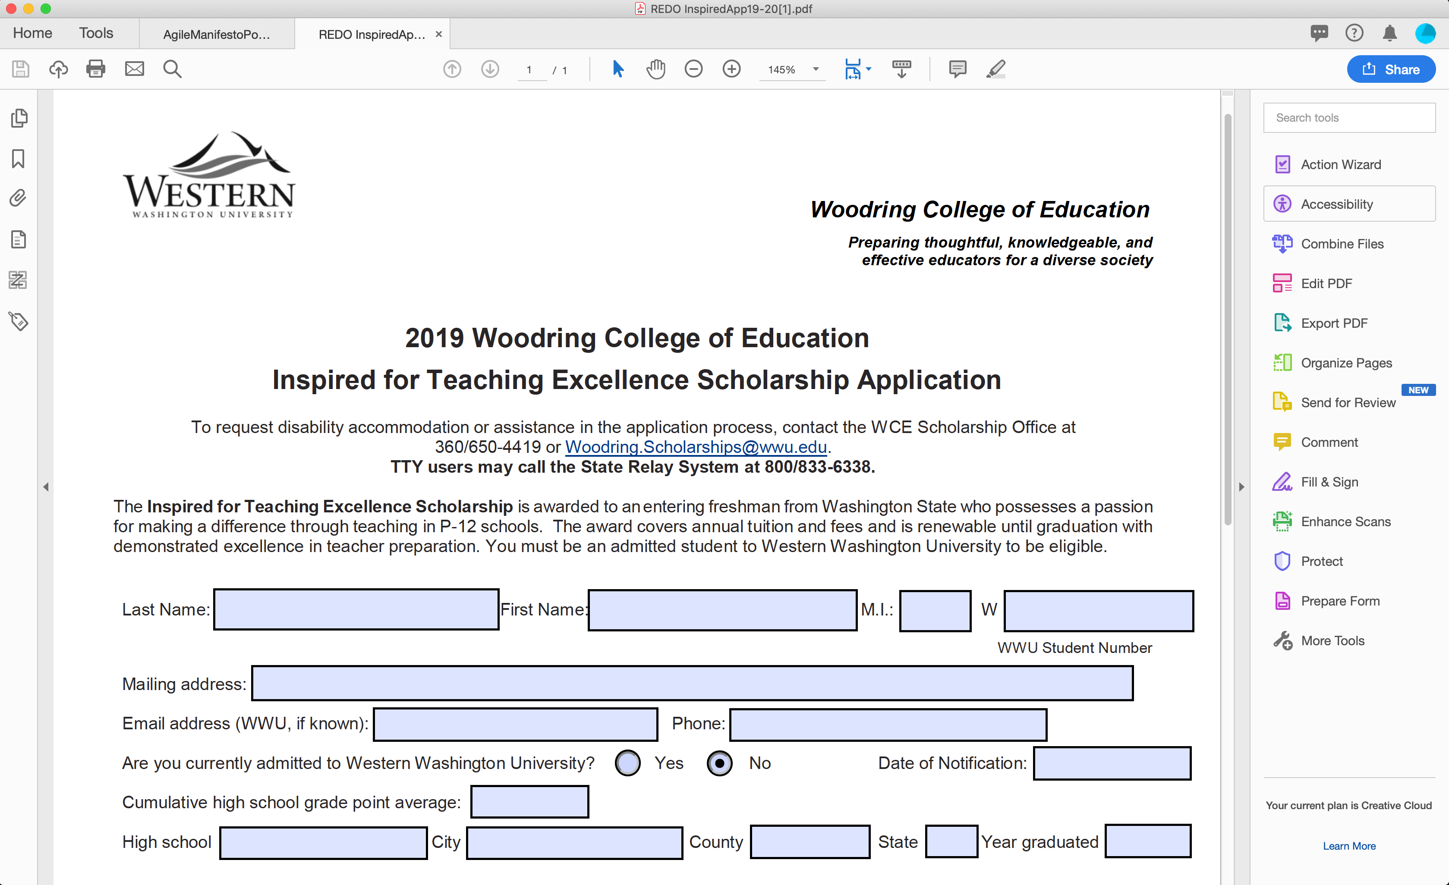
Example Form (final PDF)
Use either Prepare Form tool, or add form fields using Action Wizard (covered later)
Accessible Fillable Forms by Karen McCall
Notes:
I repeat this process over and over until I have my final form, and then add inputs in Adobe which you can see in this image. You'll notice now the spaces include text inputs where necessary, or radio buttons for things like yes/no questions. To create these inputs you can use the prepare form tool or add form fields using the action wizard, which we'll cover later. I highly recommend checking out Accessible Fillable Forms by Karen McCall, since this is the booklet that helped teach me how to create fillable forms.

Slide 17
Does the document have links?
Use the link option in the Edit PDF tool to add links
Shouldn’t need to do this if creating links accessibly in Word, InDesign, etc.
Notes:
You'll also need to consider if the document has links. If you are creating the document in Word, PowerPoint, in design, etc., you shouldn't have to recreate the links in Adobe. If you're creating links from scratch in Adobe, you can use the link option in the edit PDF tool to add links.

Slide 18
Does the document have multimedia?
Video
Needs captions, audio description if visuals aren’t narrated
Images
Need proper alt text
Complex Images
Need longer description or text alternative (table, summary, etc.)
Notes:
Before converting to PDF you also need to consider if the document has multimedia. If the document has video, then the video needs captions, and audio description if the visuals aren't narrated. If there are basic images, then they need proper alt text. If there are complex images in the document, such as charts or complex diagrams, you may need to supply a longer description In addition to alternative text. If it's a bar chart for example, you may want to provide a table or text-based summary in addition to the image’s alt text.

Slide 19
Prep Steps Taken Care of?
Not an image of text?
Form layout prepped?
Links added?
Multimedia accessible?
Ready for PDF!
Notes:
So if you have successfully taken care of these prep steps-- the document is real text, any form elements are formatted properly, links are added, and multimedia is accessible-- then the document is ready for PDF conversion. Step 2 is then saving to PDF.

Slide 20
Step 2. Convert to PDF
Notes:
Step 2 is then saving to PDF.

Slide 21
Save an accessible PDF in Office
Windows
MacOS
Click File > Save As and choose where you want the file to be saved.
In the Save As dialog box, choose PDF in the Save as type list.
Click Options, make sure the Document structure tags for accessibility check box is selected, and then click OK.
Click Save.
Select File > Save As (or press Command+Shift+S), type the file name in the Save As text box, and then choose where you want the file to be saved.
In the Save As dialog, go to the File Format drop down box. Use the Down Arrow to browse through file types, and select PDF.
Select the radio button "Best for electronic distribution and accessibility (uses Microsoft online service)." This ensures the PDF is tagged.
Select Save.
Source: Microsoft, Create accessible PDFs
Notes:
If working in Microsoft Office, the best way to create an accessible PDF is to select file and then save as PDF. This slide includes instructions for both windows and Mac, which I borrowed from Microsoft's own instructions on creating accessible PDFs.

Slide 22
Warning: Create PDF
Make sure to go to Save As and then choose the PDF format type.
Don’t use the “Create PDF” option!
Notes:
You might see some other options like Acrobat panes in Word that then allow you to create a PDF, or choose a print to PDF option to then save A PDF document. I don't recommend using either of these methods, because Accessibility info may not carry over to the digital PDF, and these aren't even methods that Microsoft recommends. So, for more predictable results, you're better off choosing file and then the "Save As” dialog.

Slide 23
Export PDF in InDesign
Can export as either interactive or print PDF
Supposedly either works, but interactive would make sense if user will interact with the document digitally
Notes:
If you're starting in InDesign, you can export PDF as either interactive or print. Apparently either one works according to the documentation, but interactive would make more sense if a user were using the document digitally.

Slide 24
Step 3. Use Adobe Accessibility Tools
Notes:
In Step 3, we need to use Adobe Accessibility tools to finalize the PDF document. while ideally the document converts to PDF perfectly every single time, this is not always the case. Sometimes heading structure can get messed up, and there may be artifacts that get carried over into PDF and need to be hidden. Adobe's Accessibility tools can help make the document accessible to PDF standards.

Slide 25
The Tools
Action Wizard
Accessibility
Runs tasks, including a “Make Accessible” task
Can go through a lot of the prep steps if working with only PDF
Options for auto-tagging, adjusting reading order, running full accessibility checks
Notes:
There are two tools in Adobe that can help with this: action wizard, which runs a make accessible task, in the Accessibility tool, which can help adjust reading order and run Accessibility checks.

Slide 26
Action Wizard Make Accessible
Find Action Wizard in Tools and add to tools panel
In Action Wizard, choose Make Accessible task
Go through the steps
Notes:
To run the make accessible task, you can find the action wizard in the tools tab and add it to your tools panel in Acrobat. Then when you choose the Action Wizard tool, you can choose the Make Accessible task and go through the steps by hitting Start.

Slide 27
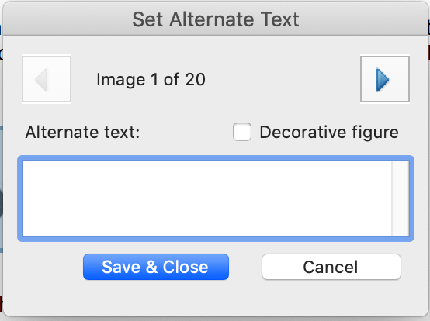
Make Accessible Gotchas
In the Recognize OCR step, keep the output as searchable image
Might sound counterintuitive, but the text will still be text and not an image
The alt text dialog can be confusing—making users close the dialog too soon
Go to next image to alt text
Save and close when completely done
Notes:
There are some gotchas when running Make Accessible. when you come across the recognize OCR step, you'll want to keep the output as searchable image. This is not intuitive, but your document text will still be text and not actually an image.
The alt text dialog can be confusing as well. If you have multiple images, you'll want to hit the right arrow to go to the next image, and then save and close when completely done alt texting. I've saved this step too early because I forgot that you can just hit the right arrow to go to the next image.

Slide 28
Accessibility Checker
Make Accessible
Accessibility
Notes:
Acrobat also comes with an Accessibility checker, which will be the final step in the Make accessible process. you can also run this check anytime using the Accessibility tool by clicking full check.

Slide 29
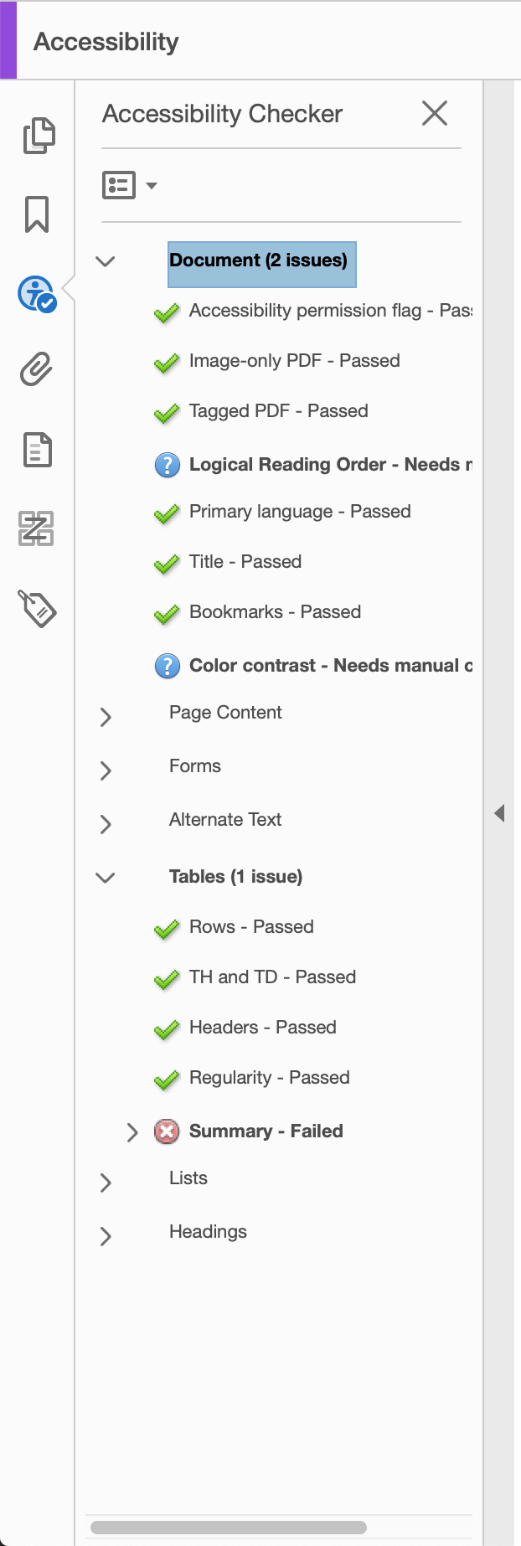
Accessibility Checker Results
Notes:
When the check is done running, you can find your results on the left side of Adobe under the Accessibility option. Ideally there will be check marks everywhere, but in this case we have a failure by not including a table summary. There are also some manual checks that will always flag as an issue because it can't automatically check for logical reading order or color contrast-- those require human checks.

Slide 30
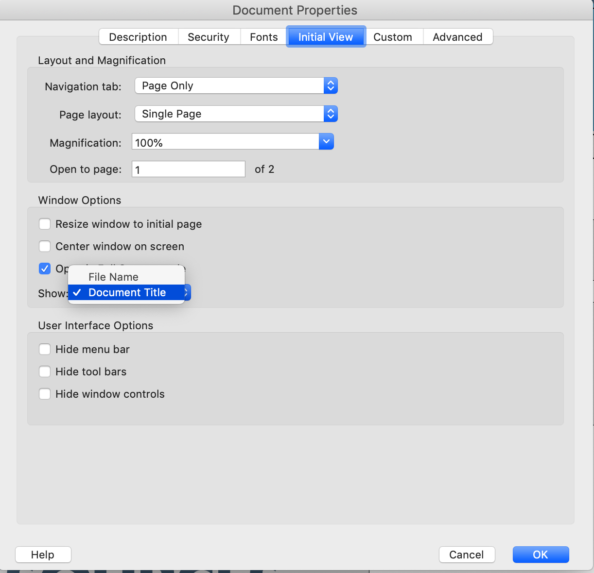
Accessibility Checker Gotchas
Title error
Go to File → Properties → Initial View, choose Show Document Title
Notes:
There are some gotchas with the Accessibility checker as well. A common one is with the title. to fix this usually you can go to file, then properties, then initial view, and select show document title instead of filename.

Slide 31
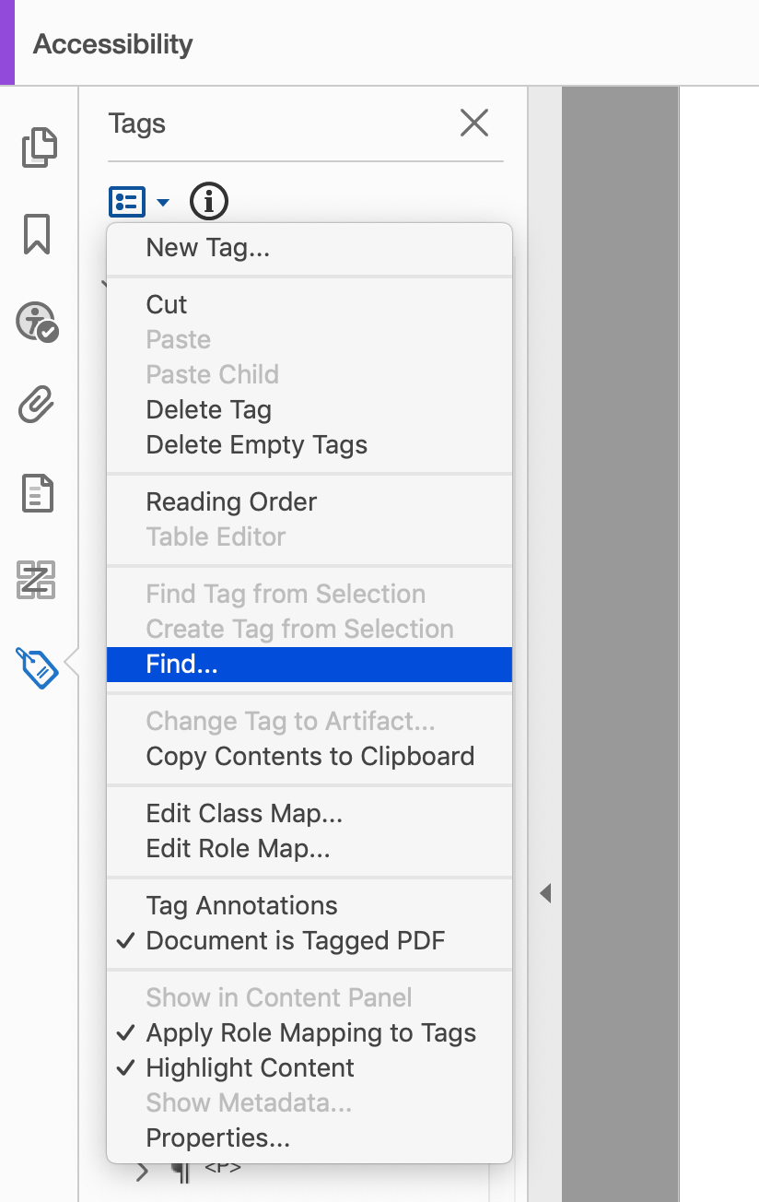
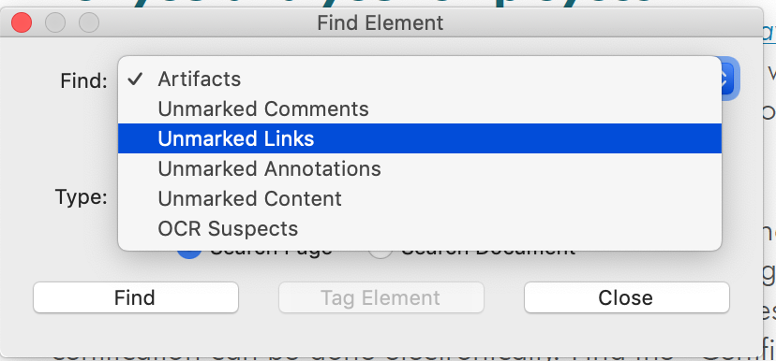
Accessibility Checker Gotchas (pt. 2)
Untagged content/annotations/artifacts—in Tags panel, go to Options → Find
Notes:
Another gotcha is with untagged content or annotations or artifacts. Under Accessibility if you go to the tags panel, you should be able to hit options and then find. From there you can find unmarked annotations, unmarked content or unmarked links, and then tag them in the structure to remove that error.

Slide 32
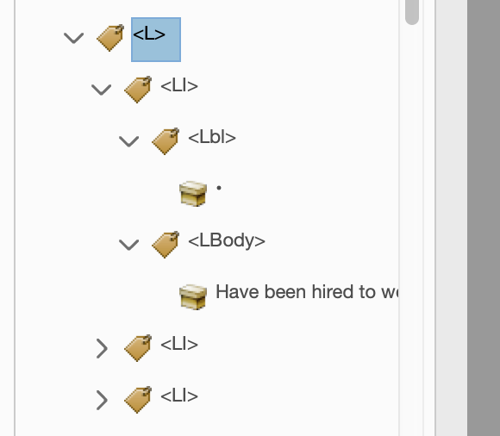
Accessibility Checker Gotchas (pt. 3)
List issues—check your list tags
Each list contains list items, list items contain <Lbl> (for bullet/number) and <LBody> (for list text)
Notes:
Issues with lists are also very common, the key here is to make sure lists are properly tagged. under each list tag there should be only list items, and each list item contains a <Lbl> tag for the number or bullet, and <LBody> for the main list item content.

Slide 33
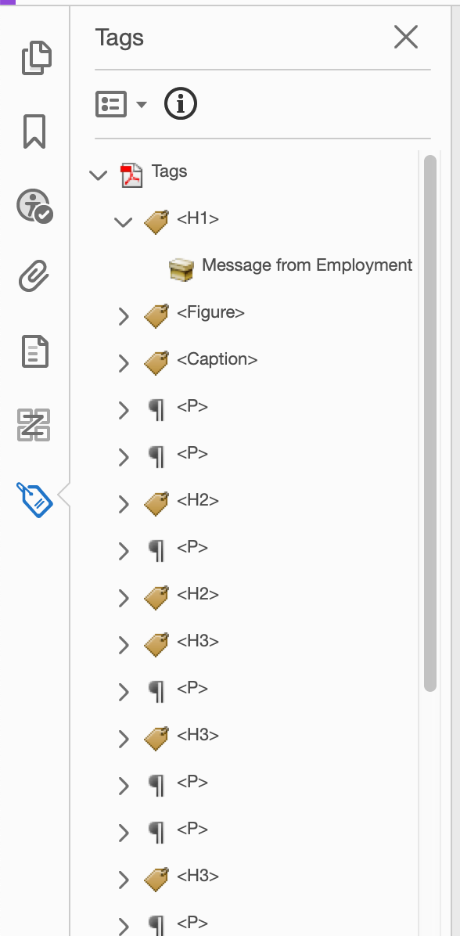
Tagged PDF
Notes:
Once we go through our Accessibility checks and fixes, we should have a tag structure that looks similar to this image, where we have an H1 for the title of the document, a figure that has proper alt text with the caption if needed, paragraphs, headings that have a logical structure, and so on.

Slide 34
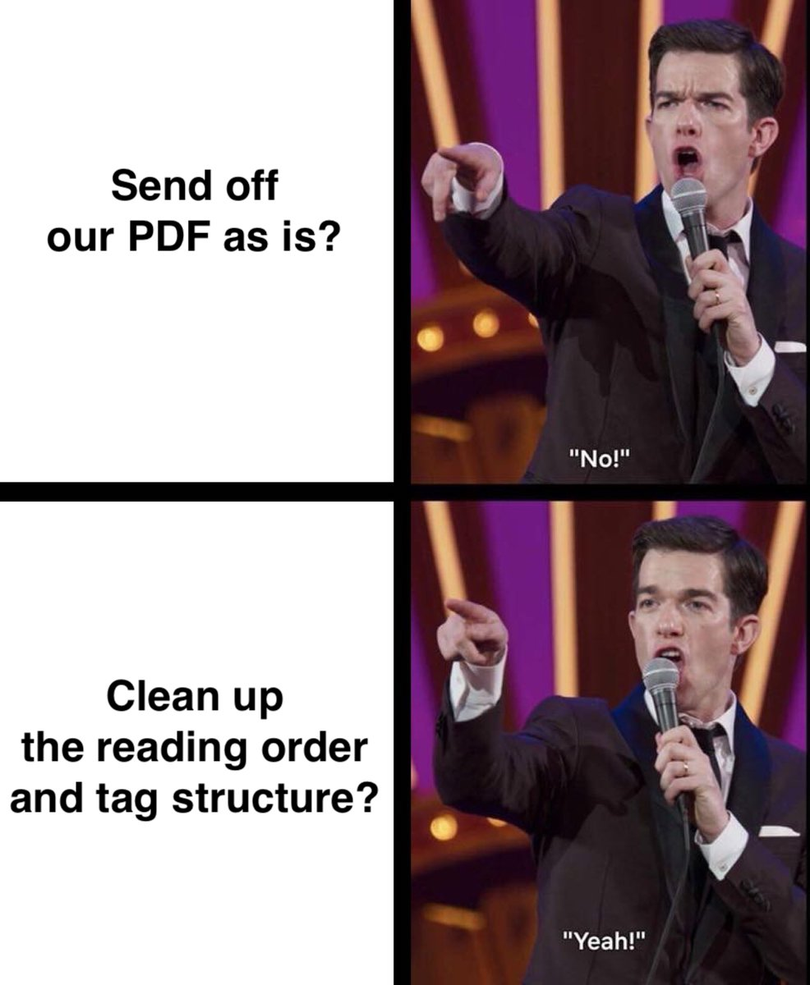
So, what now?
Notes:
So what do we do with our PDF now? Do we send off our PDF as is? John Mulaney says “no!” do we clean up the reading order and tag structure? John Mulaney says "yeah!”.

Slide 35
Double-check your tags and reading order
Auto tagging doesn’t always map correctly
H1 in Word can become H3 in PDF
In Tags panel, right click a tag, then select Properties to choose what tag it should be
The reading order may also be off
Notes:
We will want to double check the tags and reading order of the document, because auto tagging doesn't always map correctly. Sometimes heading levels can be messed up or lists are rendered as paragraphs. If that happens, you can go into the tax panel select A tag and then adjust the properties to choose what tag it really should be.
The reading order of the document can also be off.

Slide 36
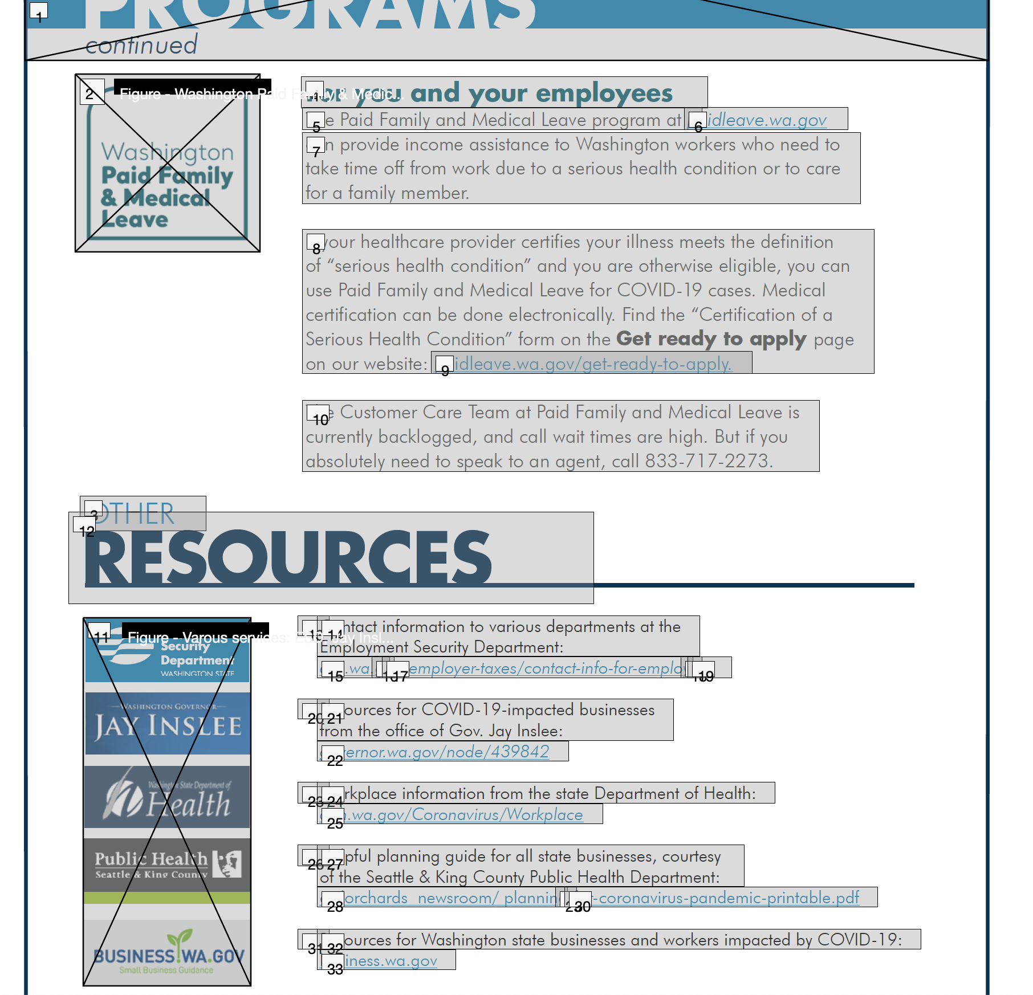
Example: Reading Order
Order goes from 3 to 12, that’s not right…
Open Accessibility → Reading Order, then either re-tag elements, or adjust order in the reading order panel
Notes:
In this example, we have a document from the state about coronavirus resources, but when I look at the Other Resources heading, I see that the word other is item 3 in the reading order, while resources item 12. this isn't right, because respectively these should be items 10 and 11. You can clean up the reading order by going to the Accessibility tool, going to reading order, and then dragging the items to the correct order.

Slide 37
To Recap
If the content doesn’t have to be PDF, choose another format
It can still be accessible, but without all that work
Optimize the document before it becomes a PDF
Document is text-based, not image
Forms should not have underlines to mimic fields, should be spaced properly, etc.
Multimedia is accessible
Links are identified and have meaningful names
Notes:
To recap, it's the content doesn't have to be a PDF we recommend choosing another format. Your content can still then be accessible without all the work a PDF can take. If it absolutely needs to be a PDF, then you should optimize the source document. You should make sure the document is text based and not an image; forms should be formatted properly and avoid underlines mimicking fields; multimedia should be accessible in the source document; and links are identified and have meaningful names.

Slide 38
To Recap (cont’d)
Use “Make Accessible” in Action Wizard and the Accessibility tool
If you’re not sure about a PDF’s accessibility, ask!
Notes:
In Adobe you will want to use the make accessible action in the Action Wizard, and the Accessibility tool for any tag and reading order clean-up. if you have any questions or aren't sure about a PDF's Accessibility, you should ask.

Slide 39
Contact Us
Western Digital Accessibility
https://www.wwu.edu/access/
Carly Gerard
Accessibility Engineer
Email: gerardc@wwu.edu
Phone: 360-650-3944
David Engebretson, Jr.
Digital Tech Accessibility Coordinator
Email: engebrd2@wwu.edu
Phone: 360-650-7755
Notes:
You can contact me or my colleague David by phone or email, and find our contact info at wwu.edu/access

Slide 40
Stay Home and Healthy!
Notes:
. I hope you are staying home and healthy. Thank you for watching this presentation.

